Slide 1
GROCERY PAL
Helping you find groceries on the web

Slide 2
Problem description
Buying groceries online is not very popular in South Africa.
Manually searching for each individual grocery item in a website can be time consuming.
The problem GroceryPal(Friend) tries to solve is how to enable anyone to efficiently find the grocery items that they are looking for on the Web with minimum effort.
To solve this, an intelligent approach to searching is required.
The following slides the class diagram and a high-level overview of the solution.

Slide 3
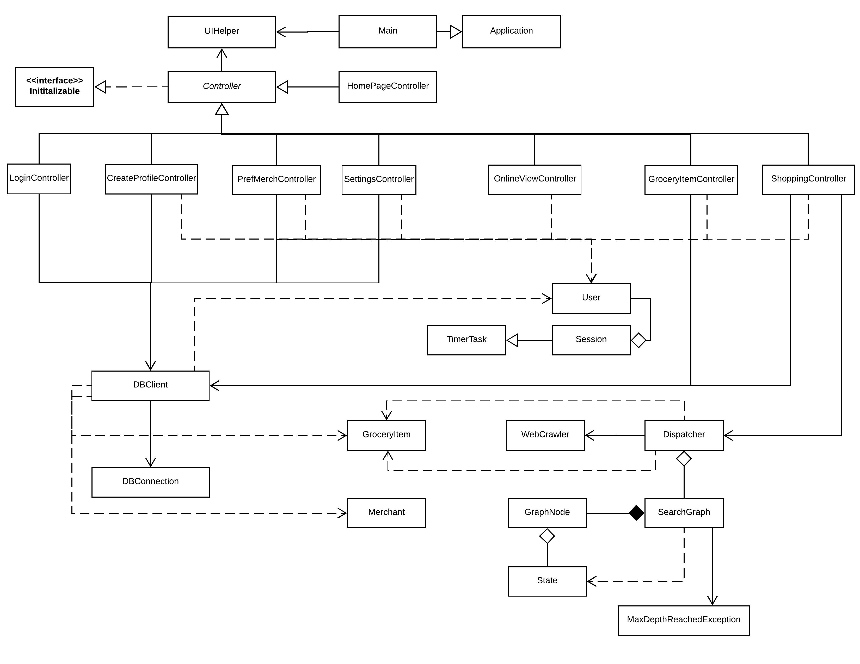
GroceryPal class diagram

Slide 4
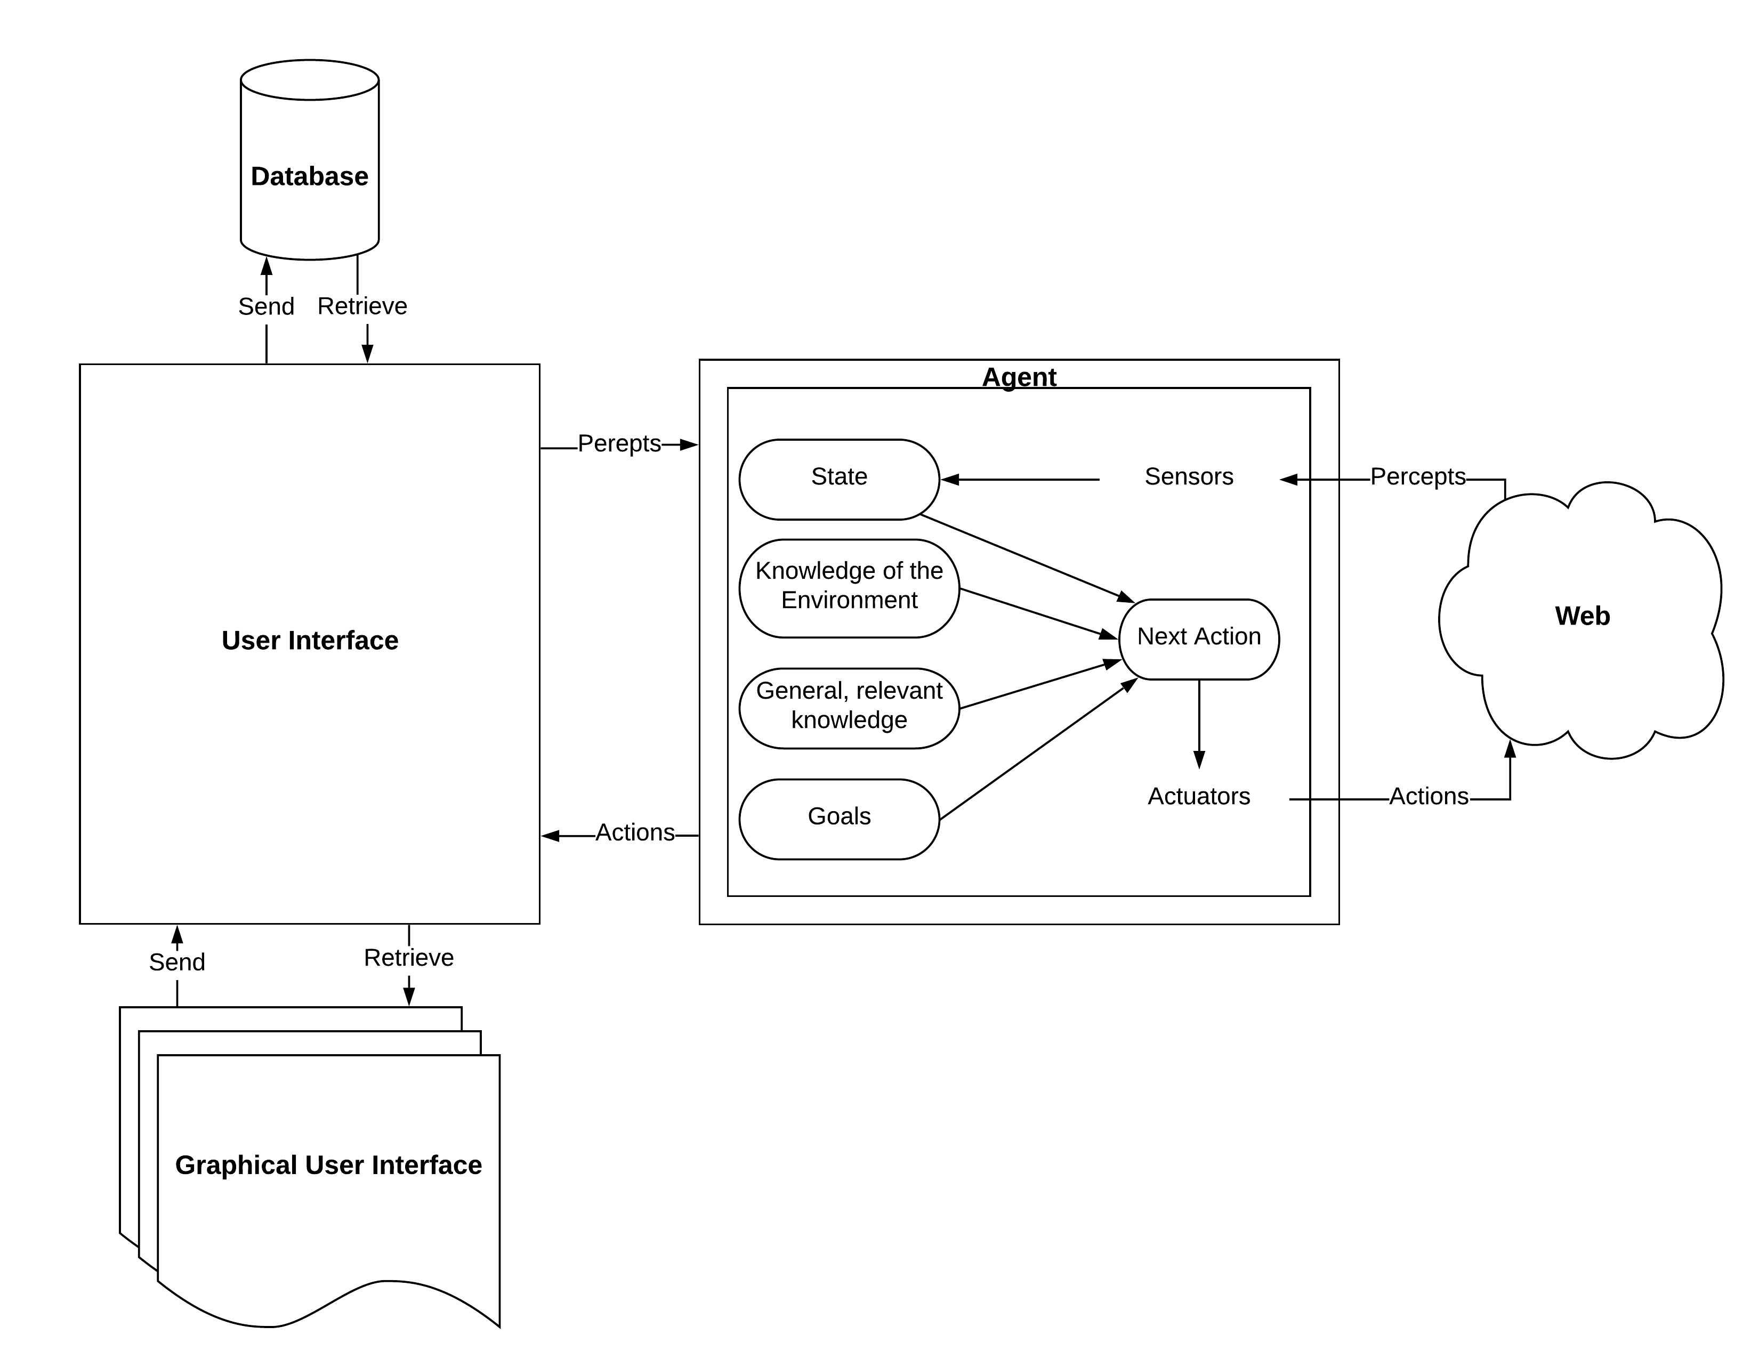
High level view of the system

Slide 5
Technical details
GroceryPal was developed using the Java programming language.
The Java FX 8 library was used to develop the system’s Graphical User Interface.
The whole solution is approximately 1500 lines of pure Java code, excluding FXML files(code generated using SceneBuilder.
Why is GroceryPal intelligent?
The solution uses both uninformed and informed search strategies hand-in-hand to achieve the most optimal results.
The agent maintains general knowledge that it uses to improve its search over time.

